Slide 1

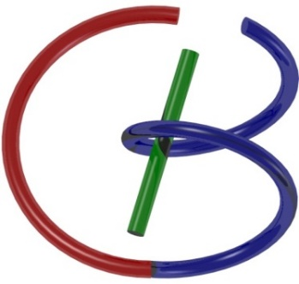
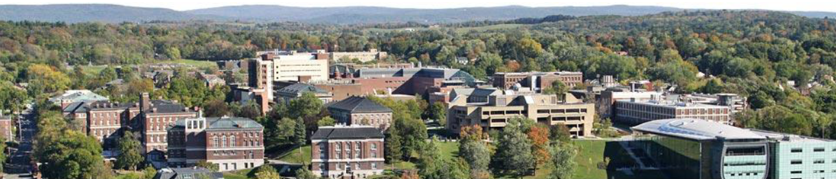
Minds-on & Hands-on MNIST
Ge Wang
AI-based X-ray Imaging System (AXIS) Lab
Rensselaer Polytechnic Institute, Troy, New York, USA
September 17, 2021
Notes:
Hello, since Professor Wang has a conference today out of town, I will give this hands-on introduction based on this PPT we prepared together. As he mentioned last time, we will have deep learning final projects by the end of the semester. Tentatively, we will have five lectures on deep learning hands-on, including this one.

Slide 2
MI Schedule for F21
Tue | Topic | Fri | Topic
08/31 | Introduction | 09/03 | Neuron, Network & Backpropagation
09/07 | No Class | 09/10 | Hands-on 1: Python, Colab, & TensorF
09/14 | Architectures & Training | 09/19 | Hands-on 2: MNIST Classification
09/21 | Image Quality I | 09/24 | CT Physics
09/28 | CT Reconstruction | 10/01 | Deep CT Reconstruction
10/05 | Hands-on 3: CT Networks | 10/08 | More CT Contents
10/12 | MRI Physics | 10/15 | Spin-Echo
10/19 | K-Space Theorem | 10/22 | More MRI Contents
10/26 | Mid Exam | 10/29 | Deep MRI Reconstruction
11/02 | Hands-on 4: MRI Networks | 11/05 | Nuclear Physics
11/09 | Nuclear Imaging | 11/12 | US Imaging
11/16 | Optical Imaging | 11/19 | Multimodality Imaging
11/23 | Hands-on 5: Image Conversion | 11/26 | Thanksgiving
11/30 | Image Quality II | 12/03 | Stability, Interpretability, & Others
12/07 | Overview | 12/10 | Final Exam
Office Hour: Teaching Day 5-6pm: https://rensselaer.webex.com/meet/wangg6

Slide 3
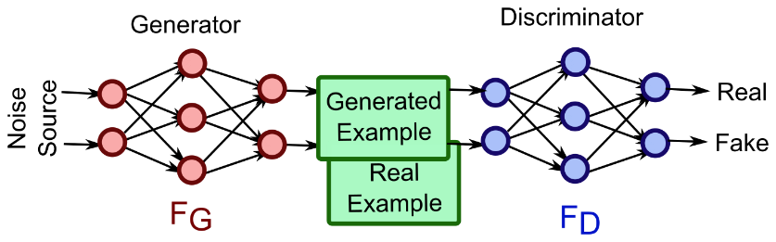
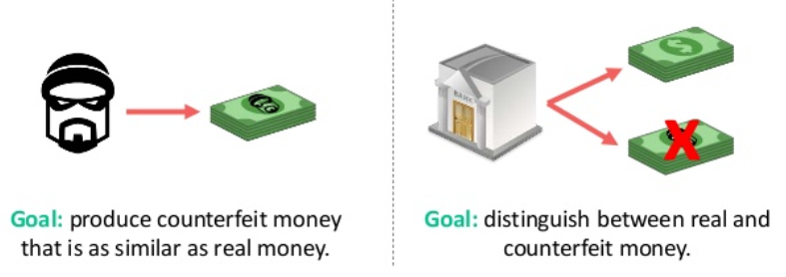
Generative Adversarial Network (GAN) Idea

Slide 4
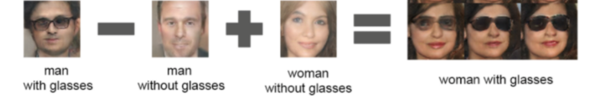

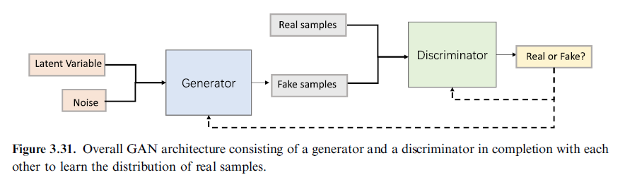
GAN Workflow
https://www.kdnuggets.com/2017/11/infogan-generative-adversarial-networks-part3.html

Slide 5
GAN Training
+
Tuning
Real
Network Output
Input
Generator
Discriminator
Loss
Ground Truth
Synthetic
Tuning

Slide 6
One-dimensional Example
Discriminator
Generator

Slide 7
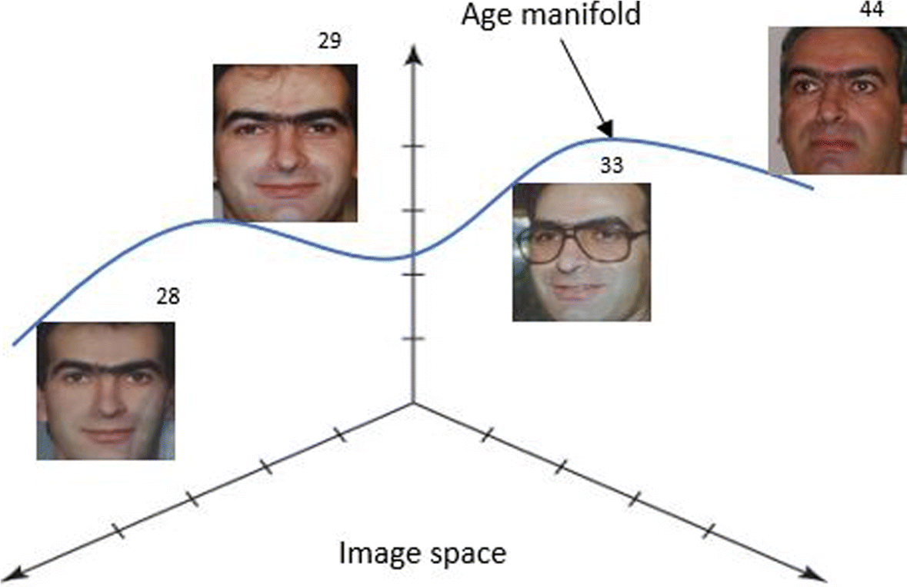
Adversarial Learning
1.0
0.5
Frequency
Synthetic/
Source/Fake Distribution
Data/
Target/Real Distribution
Data

Slide 8
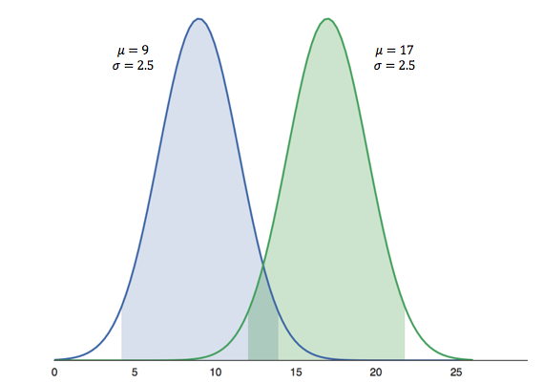
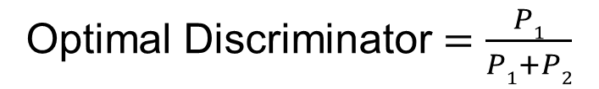
Optimal Discriminator
Optimal Discriminator $=\frac{P1}{P1+P2}$
P₁
P₂
For a new datum, if discriminator function is greater than 0.5, the datum should belong to Class 1 (blue); otherwise, it comes more likely from Class 2 (green)

Slide 9
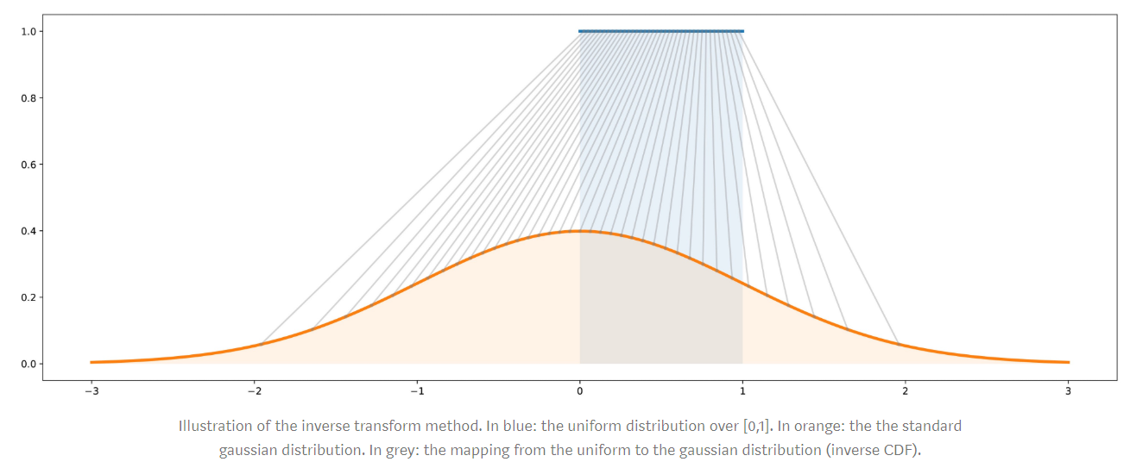
Optimal Generator
p₁
p₂
https://towardsdatascience.com/understanding-generative-adversarial-networks-gans-cd6e4651a29

Slide 10
Initial Interplay
1.0
1.0
1.0
0.5
0.5
0.5
Frequency
Likelihood
Data
Improve Generator
Data
Improve Discriminator
Data

Slide 11
Further Improvement
1.0
1.0
1.0
0.5
0.5
0.5
Frequency
Likelihood
Data
Improve Generator
Data
Improve Discriminator
Data

Slide 12
Homework
Hands-on 1: Alter aspects of the neural network, data, etc. and report the results. Try to achieve a superior network performance. Some ideas for alteration:
Network architecture (neurons, layers)
Network activation function(s)
Learning Rate
Number of epochs/batch sizes
Optional Problem
https://gertjanvandenburg.com/blog/autoencoder/
In reference to the above link, please develop a simple MNIST autoencoder in Colab/TensorFlow

Slide 13
Outline
Minds-on – Interpretation
Universal Approximation with Width
Mathematical & Logic Operations
Hands-on – MNIST
1-Layer NN & Softmax Revisited
Gradually Improved Networks

Slide 14
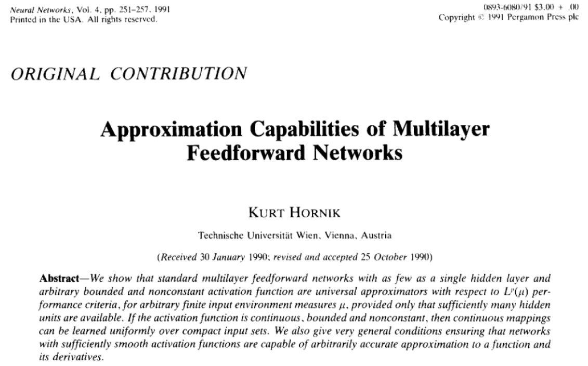
Hornik’s Work

Slide 15
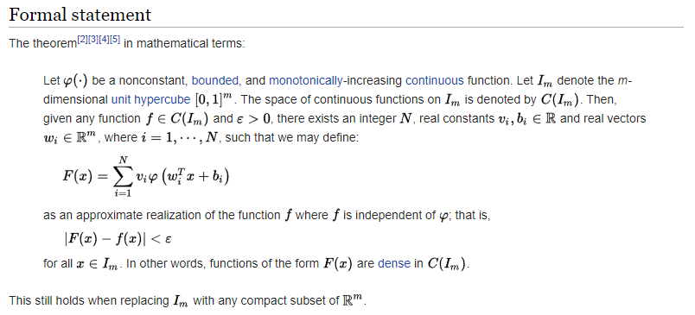
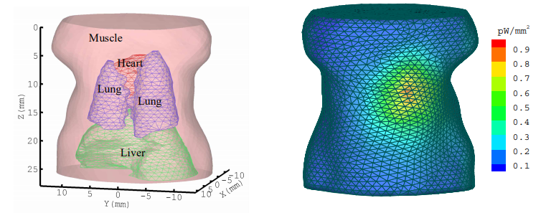
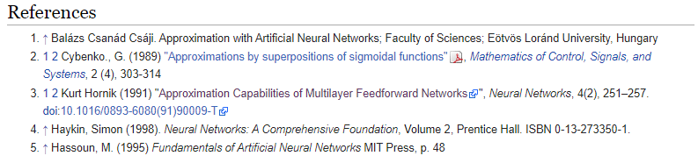
Universal Approximation
Key Idea:
Express Each & Every Element, Then Add Results together to Form the Whole Solution
https://www.osapublishing.org/oe/abstract.cfm?uri=oe-14-17-7801
https://ipfs.io/ipfs/QmXoypizjW3WknFiJnKLwHCnL72vedxjQkDDP1mXWo6uco/wiki/Universal_approximation_theorem.html

Slide 16
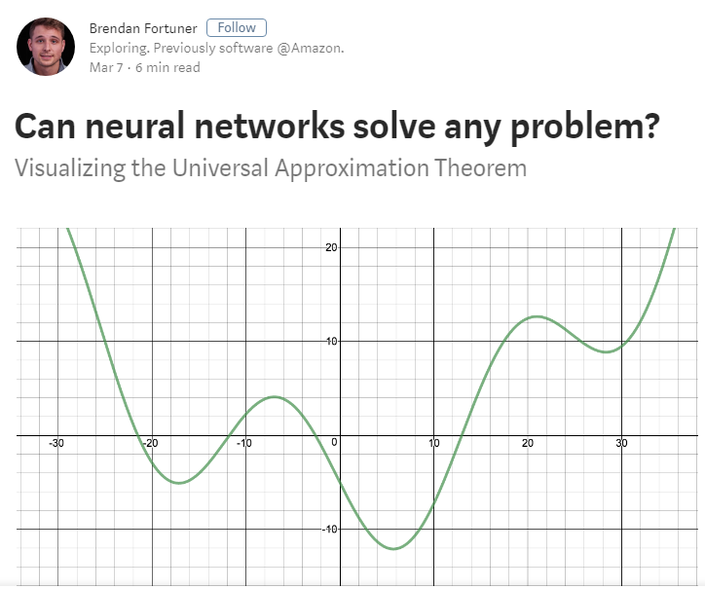
https://towardsdatascience.com/can-neural-networks-really-learn-any-function-65e106617fc6

Slide 17
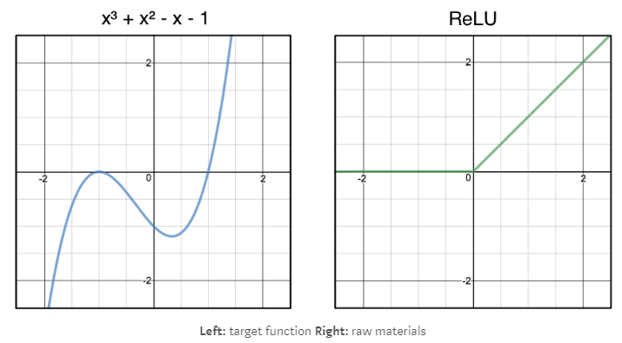
Illustrative Example

Slide 18
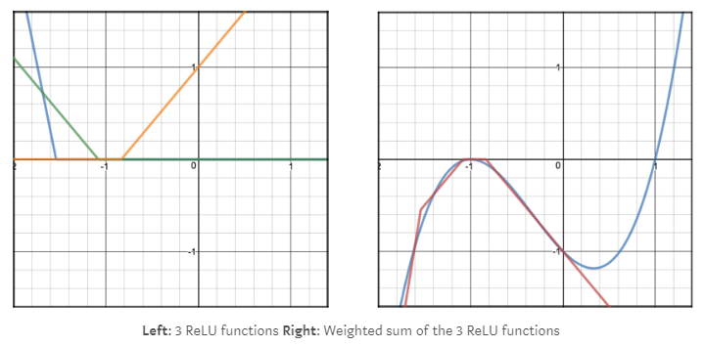
Approximation via Summation

Slide 19
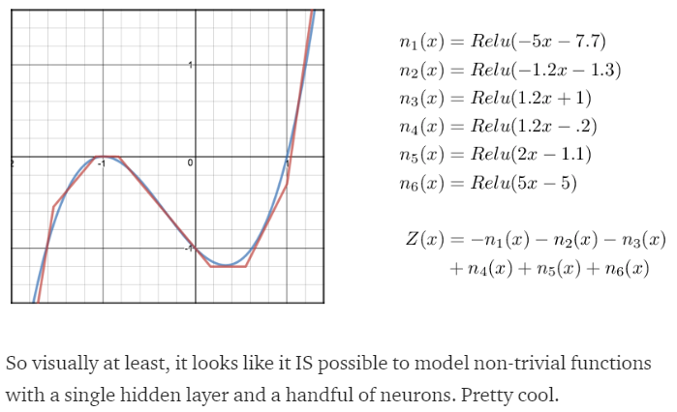
Approximation as Limit

Slide 20
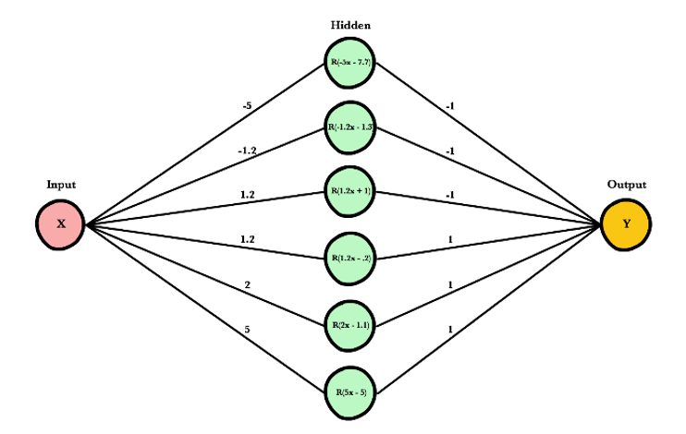
Approximation with Width

Slide 21
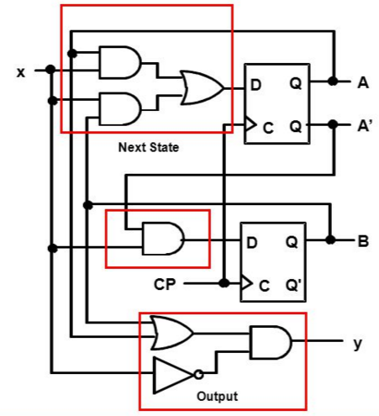

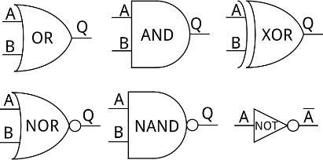
Logic Gates via Neural Network

Slide 22
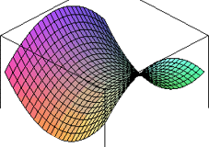
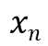
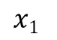
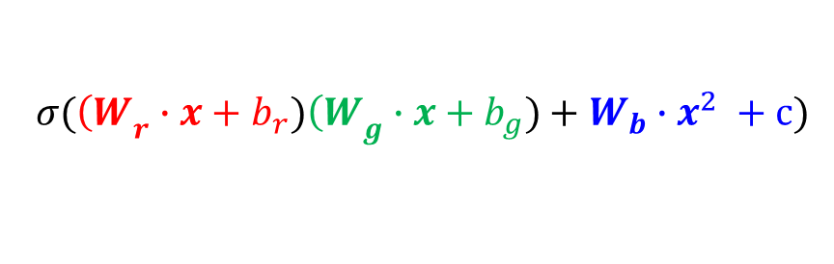
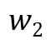
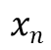
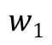
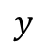
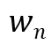
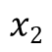
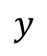
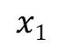
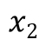
New Type of Neurons
Conventional Neuron
Quadratic Neuron
Linear
Nonlinear
Nonlinear
Nonlinear
$$x1$$
$$w1$$
$$x1$$
$$w2$$
$$y$$
$$y$$
$$x2$$
$$x2$$
…
$$wn$$
Output
…
$$xn$$
Inner Product
$$xn$$
Quadratic
Form
Input
$$σ({\left(W\right.}_{r}∙x+b_{r}){\left(W\right.}_{g}∙x+b_{g})+{W_{b}∙x}^{2} +c)$$
Fan FL, Cong WX, Wang G: A new type of neurons for machine learning. International journal for numerical methods in biomedical engineering 34:p.e2920, 2018
Notes:
Specifically, we proposed to replace the inner product in the conventional artificial neuron with a quadratic operation by multiplying two different inner products together for the same input vector, and then add another quadratic function of the input vector.

Slide 23
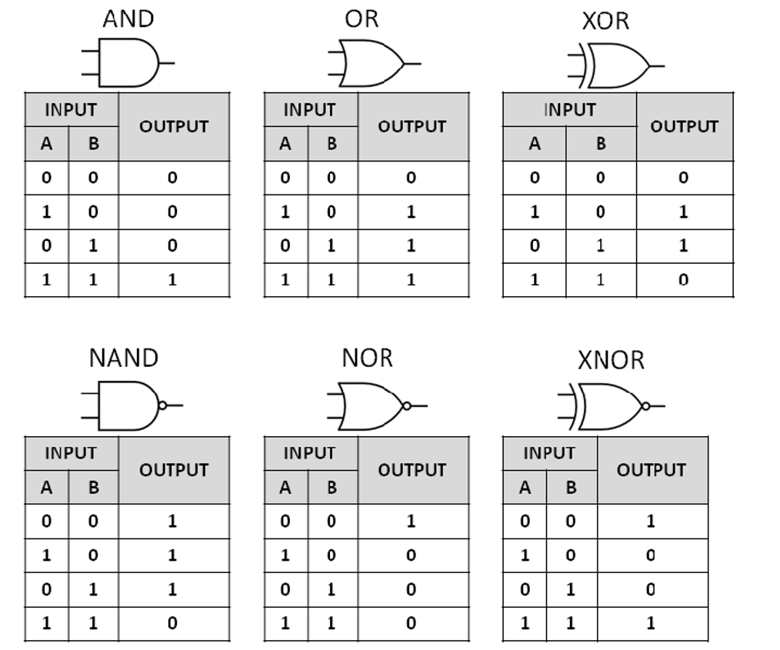
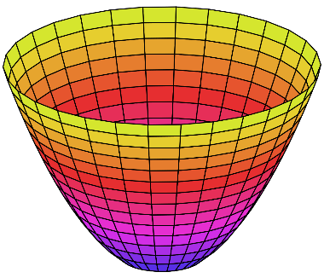
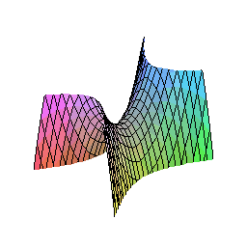
Boolean Logic Gates & More Possibilities
Parabolic
Hyperbolic
Notes:
A conventional neuron cannot implement the XOR gate. In contrast, our quadratic neuron can implement a hyperbolic function and directly implement the XOR gate. As a matter of fact, our quadratic neuron can be adapted to implement any two-dimensional logic function. Along this direction, we believe that many kinds of artificial neurons can be designed. Hinton’s Capsule idea is in a similar spirit.

Slide 24
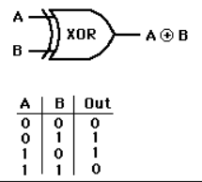
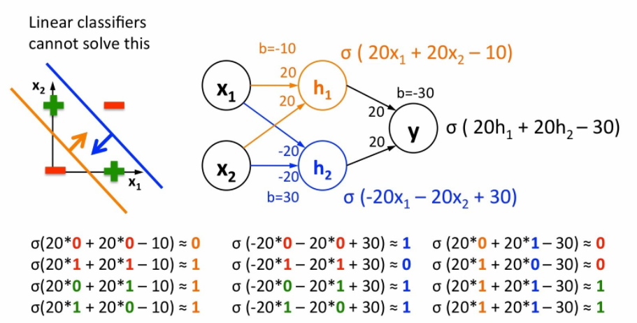
XOR Gate as Example of Logic Operations
https://www.youtube.com/watch?v=kNPGXgzxoHw

Slide 25
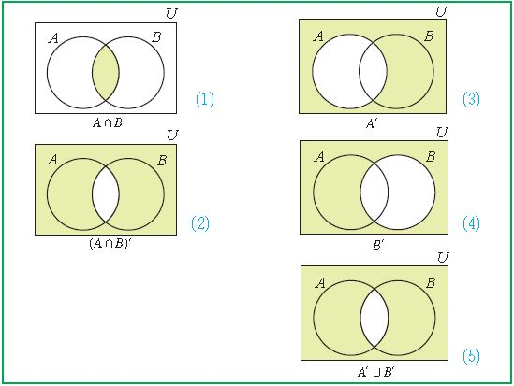
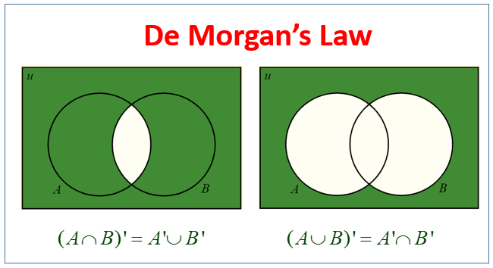
Research Question & De Morgan Law
While classic studies proved that wide networks allow universal approximation, recent research and successes of deep learning demonstrate the power of the network depth. Based on a symmetric consideration, we ask if the design of artificial neural networks should have a directional preference?

Slide 26


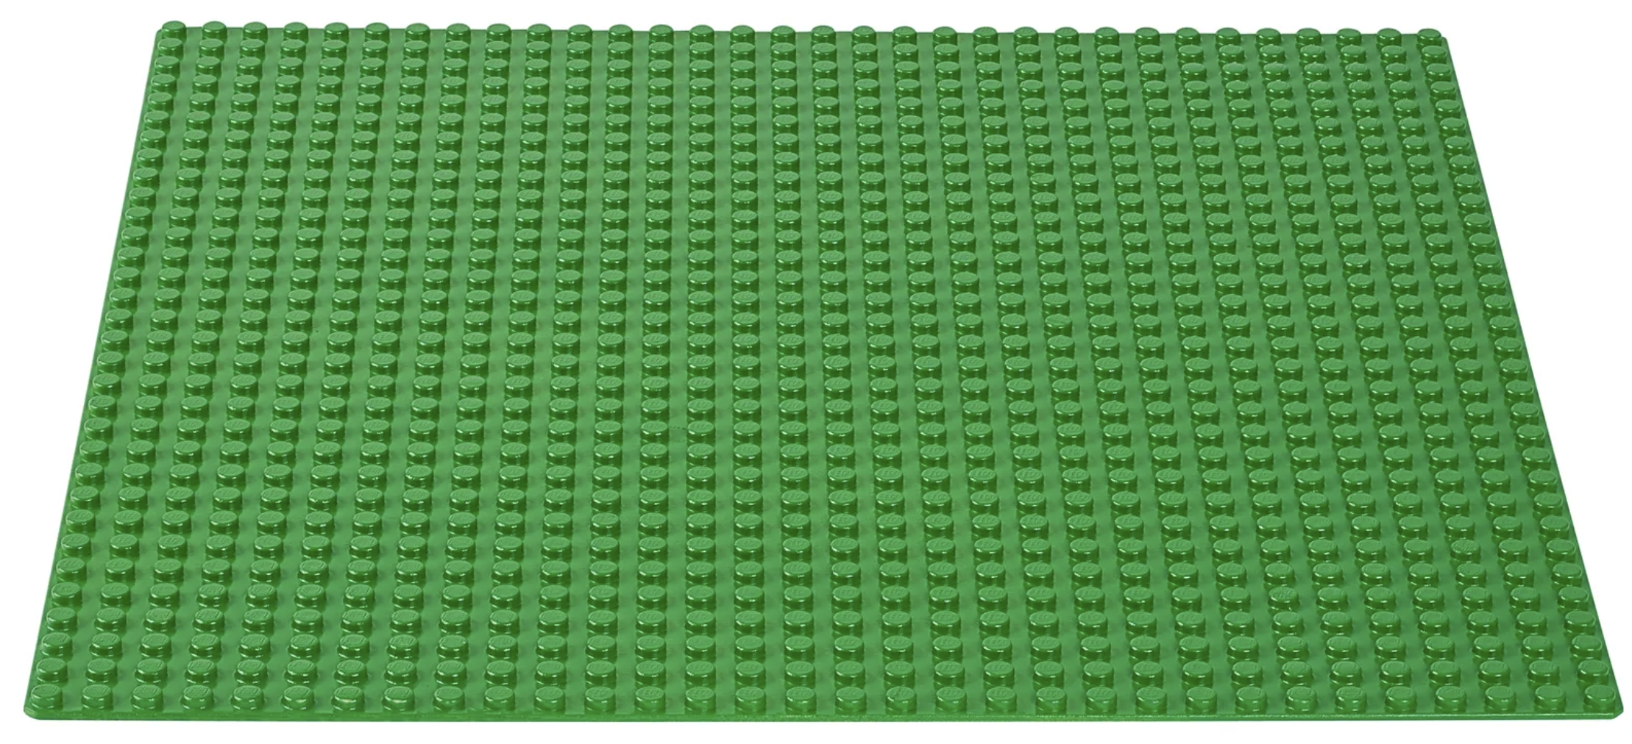
Quasi-Duality / Equivalence of Width & Depth
De Morgan’s Law:
Fan FL, Lai RJ, Wang G: Quasi-Equivalence of Width and Depth of Neural Networks, https://arxiv.org/abs/2002.02515, 2020
Notes:
In the perspective of the De Morgan’s law, the negation of a disjunction is the conjunction of the negations. inspired by this duality, we systematically analyzed the family of ReLU networks, and proved that the width and depth of ReLU networks are quasi-equivalent for either classification or regression tasks. If you are interested, please take a look at this paper for mathematical details, including several theorems and proofs.

Slide 27
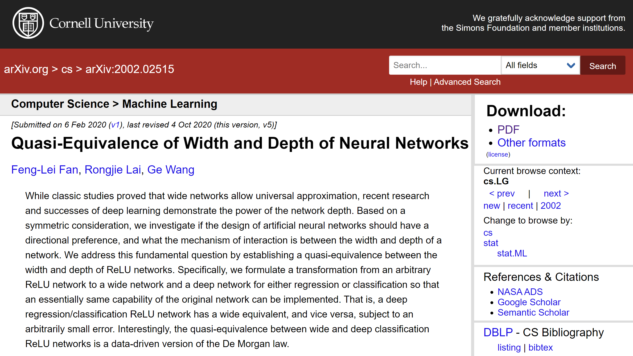

Slide 28
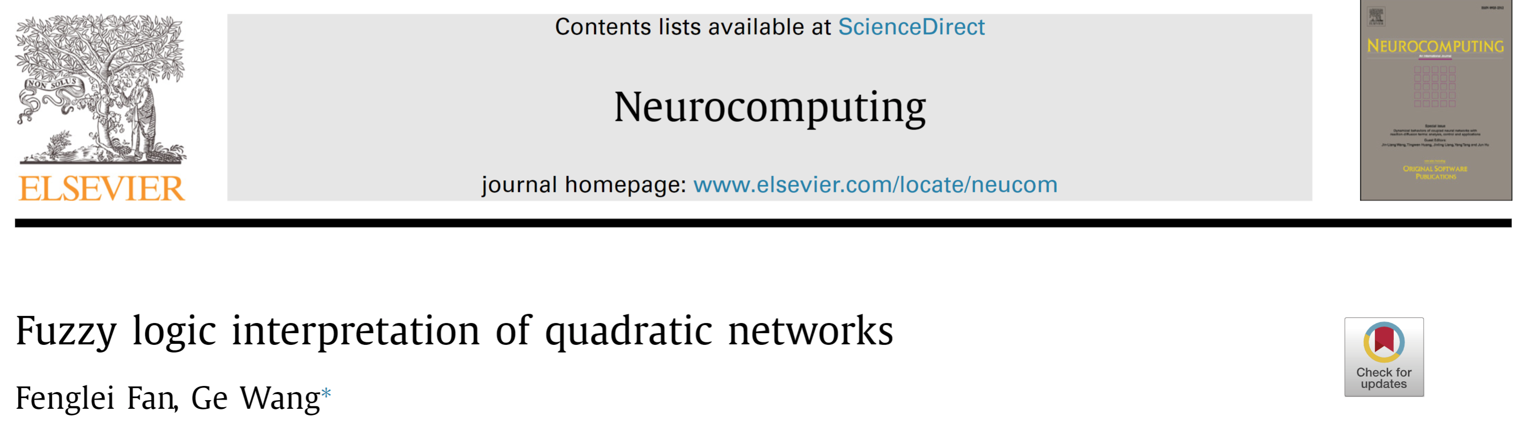
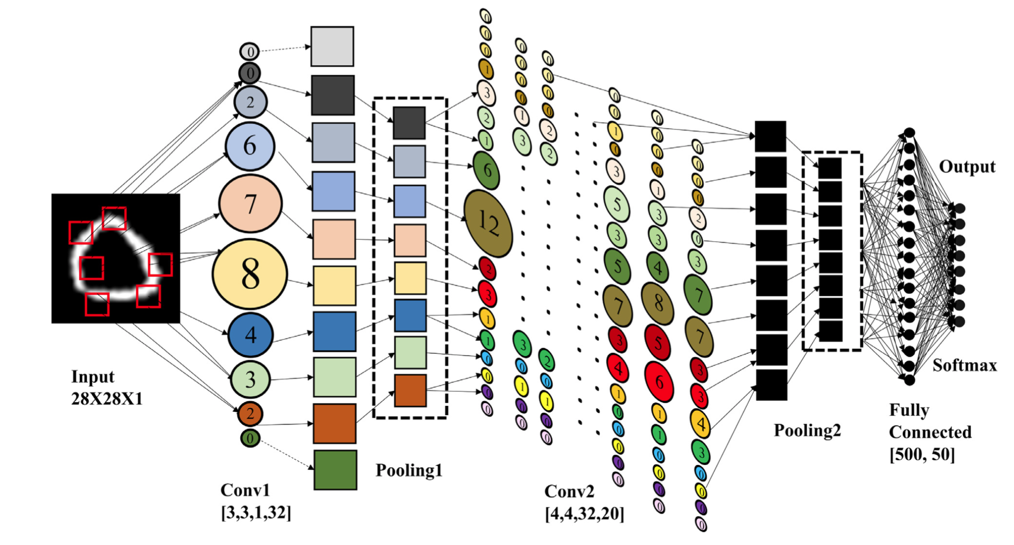
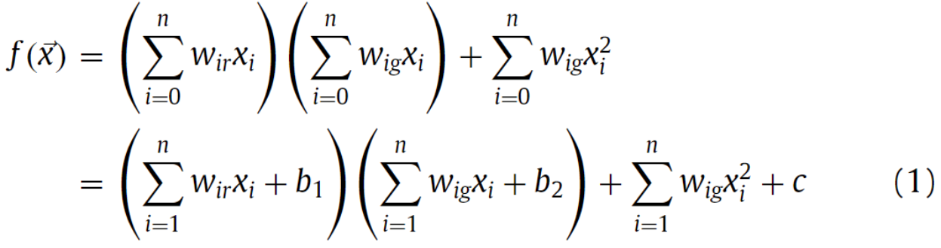
Deep Fuzzy System
Notes:
Since our quadratic neurons are continuous instead of being binary, we tend to consider them as fuzzy logic gates. Hence, a deep neural network is nothing but a deep fuzzy logic system. A digit recognition network is shown in this diagram, where the size of a quadratic neuron indicates its relative importance, while the color of a quadratic neuron shows the type of its fuzzy logic operation, for example, hyperbolic or parabolic, as determined via spectral analysis.

Slide 29
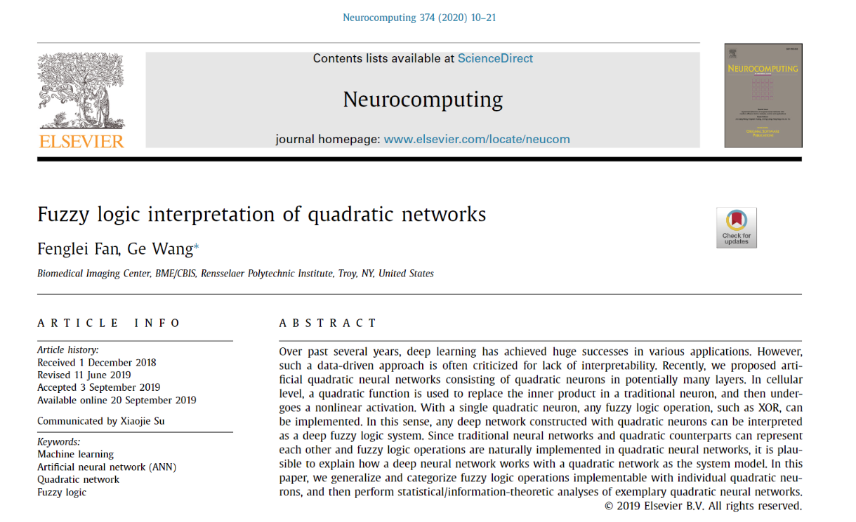
Fuzzy Logic Interpretation

Slide 30

Software Engineering Principles
Divide-Conquer
Modularity, Abstraction, Cohesion & Coupling
Formality
Generality
Scalability
Reliability
Adaptability
Iterative Refinement, Anticipation of Change

Slide 31
Outline
Minds-on – Interpretation
Universal Approximation with Width
Mathematical & Logic Operations
Hands-on – MNIST
1-Layer NN & Softmax Revisited
Gradually Improved Networks

Slide 32
Python, Colab, TensorFlow, &
MNIST Example
Christopher Wiedeman, Huidong Xie, and Ge Wang
wiedec@rpi.edu, xieh2@rpi.edu, and wangg6@rpi.edu
Sept. 10, 2021
Notes:
Hello, since Professor Wang has a conference today out of town, I will give this hands-on introduction based on this PPT we prepared together. As he mentioned last time, we will have deep learning final projects by the end of the semester. Tentatively, we will have five lectures on deep learning hands-on, including this one.

Slide 33
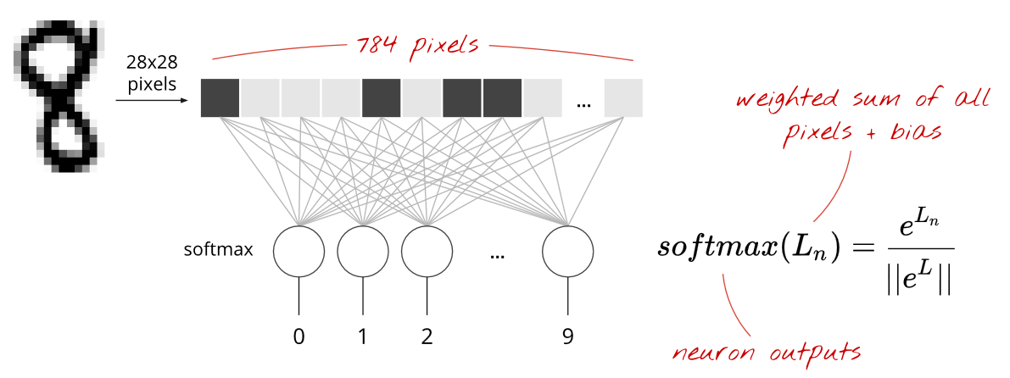
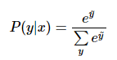
Feed Forward 1-layer Network for 10 Classes
https://cloud.google.com/blog/products/gcp/learn-tensorflow-and-deep-learning-without-a-phd

Slide 34
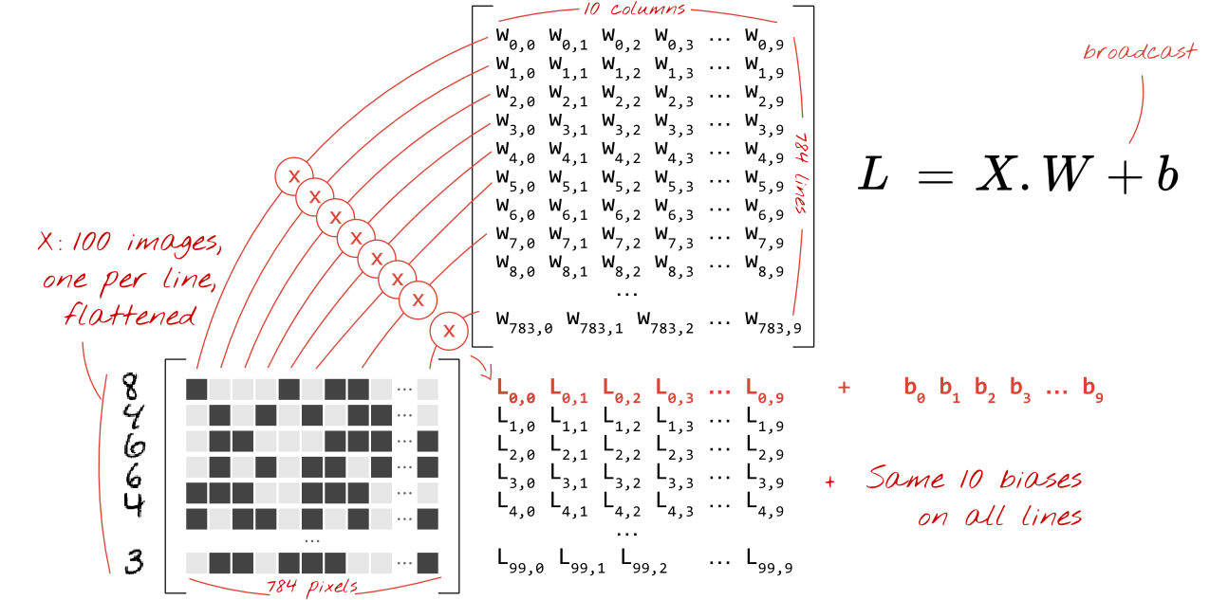
Single Layer Operation

Slide 35



Derivation of Softmax Function (Understood?)
These pseudo likelihood values are again in a relative sense!
Note -5, 7, -2 will make the denominator 0
These pseudo likelihood values are in a relative sense! –
We can set one as ground 0
Make sure non-negative
We can normalize these likelihood values to produce probabilities.
http://willwolf.io/2017/04/19/deriving-the-softmax-from-first-principles/

Slide 36



Derivation of Softmax Function
Extract Linear Features First as Pseudo Likelihoods
Make the Linear Features Nonnegative as Modified Likelihoods
Convert Modified Likelihoods into Probabilities
Maximum Probability Corresponds to the Closest Class

Slide 37


TensorFlow Implementation

Slide 38


Loss Functions: MSE or KL Distance
Kullback-Leibler Distance
https://www.quora.com/What-is-the-difference-in-minimizing-the-cross-entropy-vs-minimizing-the-KL-divergence

Slide 39

Performance with Single Layer

Slide 40


Fully-connected 5 Layers

Slide 41

Accelerating with ReLU

Slide 42

Random Dropout & Adaptive Rate

Slide 43

Pooling Strategy (Still Remember?)

Slide 44

Jump into the CNN World
Output is a hot vector of 10 elements representing probabilities for 10 digits
Conv.
Pooling
Conv.
Pooling
Flatten
Dense+ Dropout
Dense
7*7*128
14*14*128
14*14*128
10*1
We have 128 kernels in the NN, this is why we have 128 channels
28*28
28*28*128
1024*1
6272*1
Notes:
This looks like it is missing one of the ‘flatten’ or ‘pooling’ layers at the end to me. I can only count 7 layers (excluding the ‘input’ layer) in this network, but the slide prior shows eight. Also, why does the 2nd conv2d layer not increase the data size by a factor of 128? Is only one filter being applied to each ‘image’ from the previous layer?

Slide 45
Comments on CNNs
Convolution Extracts Important Features
Human Vision System, Computer Vision
Convolution Reduces the Number of Parameters
One Layer of N Neurons to Next Layer of M Neurons
FC NN: N*M (say, 512^4); CNN: s*s*# of channels (3x3*1K)
More Compact NNs: Faster to Train, Less Overfitting
More Stable, & Easier to Interpret
Occam's razor (Ockham's razor) is a scientific principle.
For two explanations/theories, the simpler one is preferred.

Slide 46
Great Performance Easily!
>99%!

Slide 47
Homework
Modify the current CNN for the best performance possible
Modifications can include but are not limited to
Number/types of layers
Parameters within layers (filter size, # of filters, stride, padding)
Learning rate
Loss function
Report your results, including the architecture and hyper parameters

